Slide 1
Prim's algorithm

Slide 2
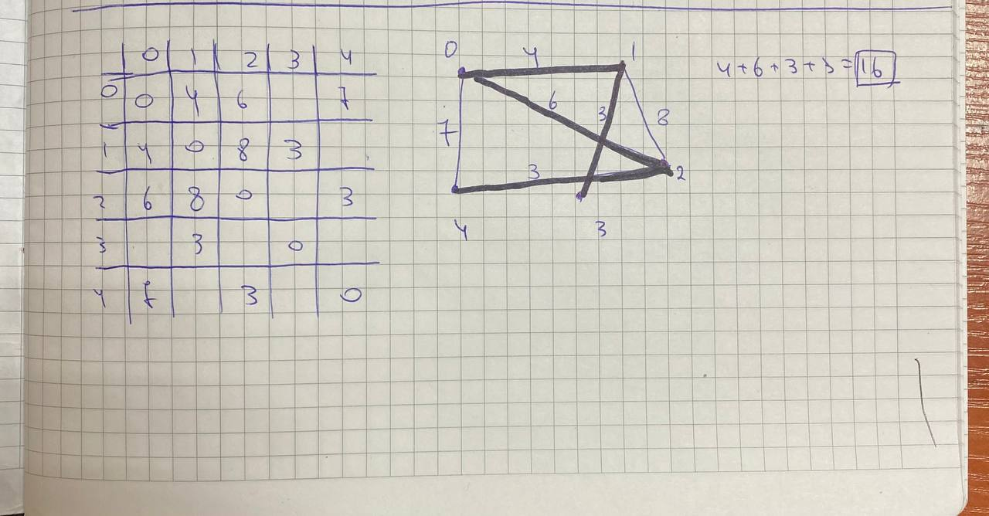

Slide 3
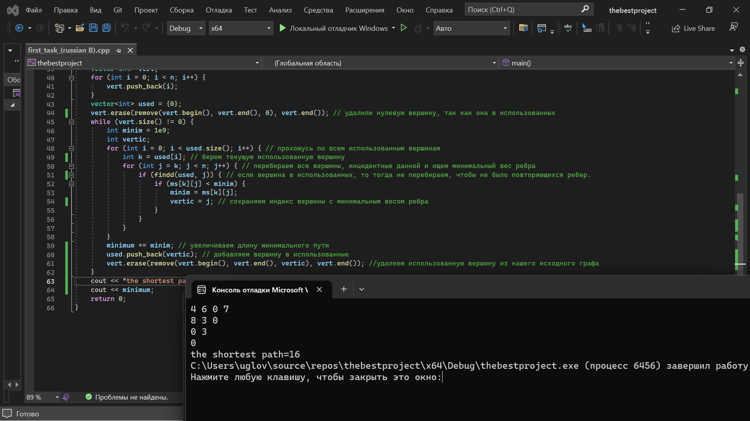
prim's algorithm

Slide 4


